Slide 1

Week 5: Hands On - Project Planning and Estimation for Online Course Registration System (OLCRS)
Michael D. Connell Jr.

Slide 2

In-Depth Characteristics of OLCRS
Intuitive user interface with accessibility features.
Robust security protocols for data protection.
Scalable infrastructure to accommodate growth.
Integration capabilities with existing university systems.
Real-time data processing for immediate updates.
Customizable features to suit departmental needs.
Notes:
Good day, everyone. Today, we're diving deep into the characteristics that make for an effective Online Course Registration System, or OLCRS.
Intuitive User Interface with Accessibility Features:
Let's start with the user interface. For our OLCRS, we aim for an intuitive design. It should be straightforward enough that students can navigate it without needing a manual. Plus, incorporating accessibility features ensures it is usable for all students, including those with disabilities. This means screen reader compatibility, high-contrast visuals, and simple navigation paths.
Robust Security Protocols for Data Protection:
Security is non-negotiable. Our system will protect sensitive student data with the latest security protocols. This includes encrypted transactions, secure logins, and compliance with privacy laws like FERPA.
Scalable Infrastructure to Accommodate Growth:
As the university grows, so does the system. We're building our infrastructure with scalability in mind, allowing for an increase in user load and course data without performance hiccups.
Integration Capabilities with Existing University Systems:
Integration is key. The OLCRS won't be a standalone system; it needs to seamlessly integrate with the existing university digital ecosystem, including academic records, billing, and communication platforms.
Real-Time Data Processing for Immediate Updates:
When a student registers for a course, the system updates in real-time. This means immediate feedback on seat availability and confirmation of enrollment, which is crucial during peak registration periods.
Customizable Features to Suit Departmental Needs:
And finally, customization. Each department has unique needs. Our system will be flexible enough to cater to those, whether it's special registration periods for certain programs or unique prerequisites.
Our goal with these characteristics is to create a system that's not just functional but anticipates and meets the needs of our diverse student body.
Now, let's move on to how we estimate the effort and duration required to bring these characteristics to life in our OLCRS.

Slide 3

Comprehensive Effort and Duration Estimation
Function point analysis considering user inputs, outputs, inquiries, files, and interfaces.
COCOMO model adjusted for team size, experience, and software reliability requirements.
Factor in project complexity, technological challenges, and potential risks.
Include buffer time for unforeseen delays and revisions.
Periodic review and adjustment of estimates based on project progress.
Notes:
As we embark on estimating the effort and duration for our OLCRS, we're not just pulling numbers out of a hat. Our approach is methodical and grounded in established estimation techniques.
Function Point Analysis: We start with a Function Point Analysis, which lets us quantify the functions in terms of user inputs, outputs, user inquiries, files, and interfaces. This is a tried-and-true method that considers the various features and user interactions our system will support.
COCOMO Model: We're also utilizing the COCOMO model. It's been tailored for our project's specific needs, accounting for the size of our team, the collective experience, and the software's reliability requirements. This ensures our estimates are as accurate as possible given our unique project conditions.
Complexity and Risks: We know that software development isn't without its twists and turns. We're factoring in the complexity of the project, the technological challenges we might face, and potential risks that could come up. By considering these variables, we ensure our estimates are robust and realistic.
Buffer Time: Anyone who's been in development knows that unexpected delays and revisions are part of the game. We've included buffer time to accommodate these without throwing off our entire schedule.
Periodic Review: Lastly, we're committed to agility. We'll periodically review and adjust our estimates based on real project progress. This adaptive approach allows us to stay on track and recalibrate as needed.
In short, our estimation process is comprehensive, calculated, and adaptable, laying a solid foundation for the successful completion of the OLCRS project. For clarity and timeline projections see the handouts given at the beginning of the meeting. We also have some next to the door in the back.
Let's move forward to discuss how we'll define parallel work activities to further refine our project timeline.

Slide 4
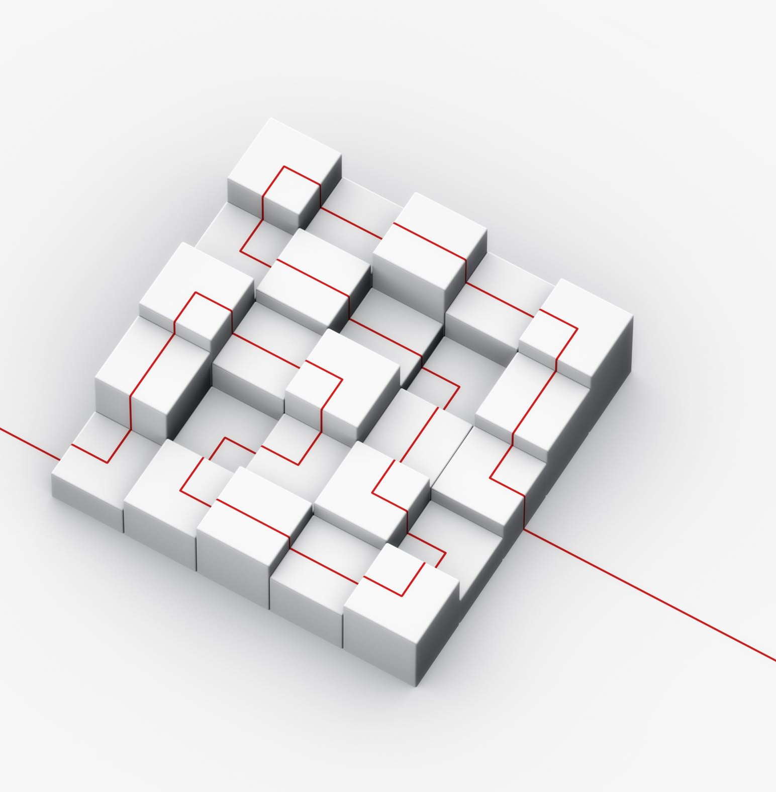
Detailed Parallel Work Activities
Development of user interface and database in tandem.
Simultaneous coding of modules and user testing.
Concurrent development of user documentation with software development.
Cross-functional teams working on different system modules.
Collaborative efforts between IT and administrative staff for smooth integration.
Notes:
On this slide, we're outlining the parallel work activities that will be pivotal in the development of our OLCRS. The maze graphic on our left visually represents the interconnected and simultaneous paths our development teams will take.
Tandem Development: We'll begin with the development of the user interface and database in tandem. This dual-track development ensures that changes in the database design immediately reflect in the user interface, enhancing efficiency.
Coding and Testing: Our software engineers will code modules while testers work alongside them, testing as they go. This simultaneous coding and user testing shorten the feedback loop and enable us to make immediate improvements, saving time in the long run.
Concurrent Documentation: Writing user documentation will occur concurrently with software development. This ensures that our documentation is as up-to-date as possible and evolves with the system.
Cross-functional Teams: We're utilizing cross-functional teams to work on different system modules. This promotes knowledge sharing and innovation, as experts from various domains collaborate to solve complex problems.
Collaboration with IT and Admin: Finally, we're fostering collaborative efforts between IT and administrative staff. This partnership is crucial to ensure the system integrates smoothly with existing university processes and workflows.
By executing these activities in parallel, we're not only optimizing our time but also ensuring that each piece of the system is being developed with a high degree of interactivity and cooperation. See team breakdown, and contact details on the back page ot the project hand out.
Next, we'll discuss how we're distributing the effort across these activities throughout the project timeline. Any Questions before moving on?

Slide 5

Strategic Effort Distribution
Early stages: Emphasis on requirement gathering and system design.
Middle stages: Focused on development, coding, and initial testing.
Later stages: Concentrated on system integration, final testing, and user training.
Allocate resources flexibly to address high-priority tasks.
Regular team meetings to assess progress and reallocate efforts as needed.
Notes:
In orchestrating the development of the OLCRS, how we allocate our efforts is as crucial as the work itself. Let's take a look at how we distribute our strategic efforts throughout the project lifecycle.
Early Stages: It all starts with laying a strong foundation. In the early stages, we pour our resources into requirement gathering and system design. This sets the tone for everything that follows, ensuring we're building a system that meets the university's needs.
Middle Stages: As we progress to the middle stages, our focus shifts to development, coding, and initial testing. This is where the bulk of our creative and technical energies are channeled, turning design blueprints into tangible software components.
Later Stages: Approaching the finish line, our concentration is on system integration, final testing, and user training. It's about polishing, ensuring seamless operation, and preparing our user base for transition to this new system.
Resource Allocation: Through all these stages, we remain flexible in our resource allocation, ready to shift our focus to high-priority tasks as they emerge.
Regular Meetings: And, of course, through regular team meetings, we keep a pulse on our progress, reassessing and realigning our efforts to stay on course towards our milestones.
As with every step of the way communication is key for us all to be on the same page and tackle obstacles as the come.
This strategic distribution ensures that at every stage, our efforts are focused, our resources are optimized, and our goals are within reach.

Slide 6
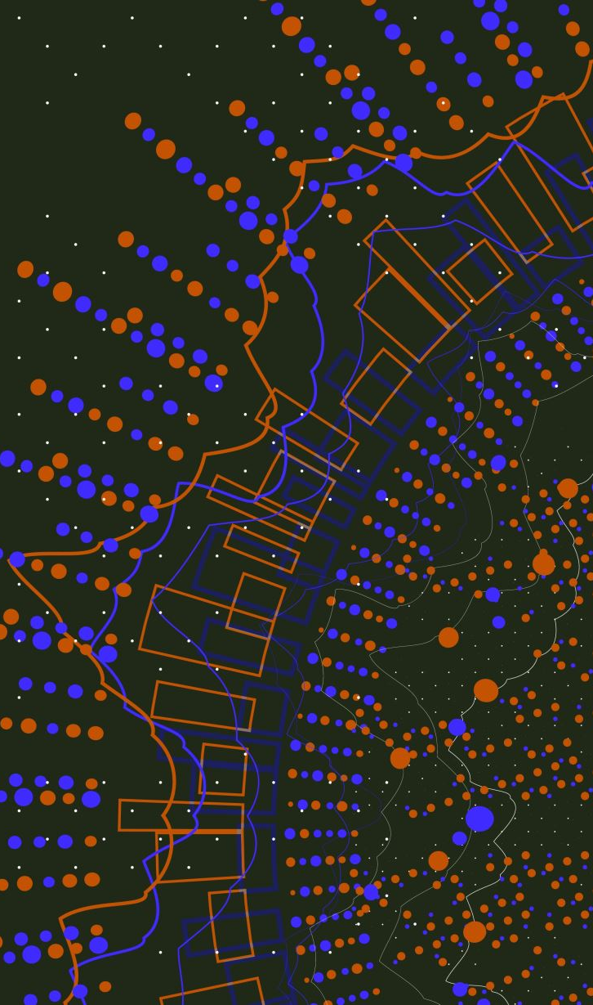
Detailed Project Milestones
Milestone 1: Completion of requirements and design documentation.
Milestone 2: First prototype development and initial user feedback.
Milestone 3: Completion of primary system development.
Milestone 4: System integration and comprehensive testing.
Milestone 5: Final deployment and user acceptance testing.
Notes:
As we navigate through the development of our OLCRS, we'll reach several key milestones that signify our progress. Each milestone is a beacon, marking our achievements and guiding us to the next phase.
Milestone 1: We begin with the foundation — completing the requirements and design documentation. This stage is about understanding what we need and planning how to achieve it.
Milestone 2: Next, we breathe life into our plans with the first prototype. It's not just about building; it's about listening — to the initial user feedback that will shape our path forward.
Milestone 3: With feedback integrated, we complete the primary system development. This is where our design transitions into a functional system.
Milestone 4: Then comes the integration — fitting all the pieces together and conducting comprehensive testing. It's a stage of refinement and fine-tuning, ensuring everything works in harmony.
Milestone 5: Finally, we arrive at deployment and user acceptance testing. This is the culmination of our efforts, where we deliver the system into the hands of the users and ensure it meets their needs.
Each milestone is a step closer to our goal. They are not just checkpoints; they're opportunities for review, for improvement, for celebration.
Let's keep these milestones in mind as we take our next steps. Onward to the timeline chart, where we'll see how these milestones fit into our overall project schedule.

Slide 7

Expanded Task Selection for OLCRS
Phase 1: Requirements analysis, feasibility study, and project planning.
Phase 2: System architecture design, database modeling, and interface design.
Phase 3: Coding of modules, initial unit testing, and integration.
Phase 4: System-wide testing, bug fixing, and user documentation.
Phase 5: Training, deployment, and post-deployment support.
Notes:
As we dissect the tasks involved in our OLCRS project, it's essential to understand the phases we've expanded upon, each with specific focus areas to ensure thoroughness and quality.
Phase 1: We initiate with a meticulous requirements analysis, conduct a feasibility study, and set out our project planning. This is the blueprint stage where we determine the "what" and the "how" of our project.
Phase 2: Moving on, we delve into the system architecture design, database modeling, and interface design. It's a creative phase where the theoretical becomes structural, forming the backbone of our OLCRS.
Phase 3: As we reach the coding of modules, the project comes alive. Initial unit testing is paired with this phase to catch issues early, and integration begins to piece together our system's components.
Phase 4: Then we enter a critical phase of system-wide testing and bug fixing, coupled with user documentation. This phase is about refinement, ensuring reliability, and creating clear guides for future users.
Phase 5: Finally, we prepare for launch with training, deployment, and robust post-deployment support. It's the phase where we empower users to make the most of OLCRS and ensure a safety net is in place as they take the reins.
Each of these phases is a step in a journey of creation and delivery. As we move forward, we'll align our efforts with these tasks, ensuring clarity and focus at every turn.

Slide 8
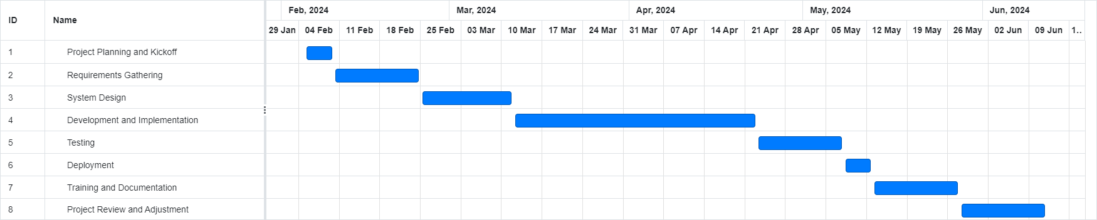
Comprehensive OLCRS Project Timeline
Notes:
This Gantt chart provides us with a bird's-eye view of our project timeline, outlining when each key phase of the OLCRS development will take place.
Initial Stages: We kick off with project planning and the official kickoff in late January, which is followed closely by an intensive period of requirements gathering.
System Design: System design begins in early February and overlaps with the tail end of the requirements phase, illustrating our agile approach to project management.
Development and Implementation: The bulk of development and implementation will occupy our team from late February through April, with testing phases interspersed to ensure quality and functionality.
Testing: Comprehensive testing phases are scheduled in May. These are critical to validate the functionality and performance of the system.
Deployment and Documentation: Training and documentation will begin in parallel with late-stage testing to prepare for a smooth transition to the new system.
Final Review: Finally, the project review and adjustment phase is set for late May into June. This ensures we have time to refine and tweak the system post-deployment, based on real user feedback.
As we progress through these phases, regular reviews will ensure we stay on track and make adjustments as needed. It's a timeline that's both structured and flexible, accommodating the dynamic nature of software development.

Slide 9

Conclusion: OLCRS Project Roadmap
OLCRS Objectives
System Development Lifecycle Overview
Strategic Approach and Task Management
Parallel Work and Resource Allocation
Project Milestones and Timeline
Commitment to Quality and User Satisfaction
Open for Feedback And Q&A

